Slide 1

Fast, easy, and secure multi-sided platform for degree verification

Slide 2




Problem
Students/Graduates
Time & Cost
4 – 6 weeks
$25 to $150
Physical diploma verification
Companies / Headhunters
Fraud Concerns
$51 M for fake diploma revenue
Third Party Verifications & Background Checks
Educational Institutions
Administrative Burden
35% of budgets go to admin staff – OCED, 2018
$34 B spent on institutional support - NCES

Slide 3






Trends and Opportunity
Globalisation
Working and studying across borders
Digital Transformation
Online Degrees & Certificates
Moving Online
Becoming more popular

Slide 4



Competitive Analysis
Central Server
How do companies and universities verify potential candidates:
Use LinkedIn
In-house Verification
3rd Party Verification
Background Checks
Don’t Care
Industry Agnostic
PDF System

Slide 5




Value Proposition
Fast, easy, and secure multi-sided platform for degree verification.
Blockchain Indefinite Storage Consolidation of Degrees Streamlined

Slide 6
Underlying Magic
Universities get full access
Access
Request
Universities
Upload data
into network
Send
Educational Institutions
Alumni
Send
Companies
Access
Request
Companies only receive and request access

Slide 7
Business Model
Students pay a fee to send verifications.
Universities pay a fee to access the network database.
Companies subscribe or pay a one time usage fee.
Universities
Future Revenue Streams
Savings
Current Cost
per Graduate
Our Service

Slide 8

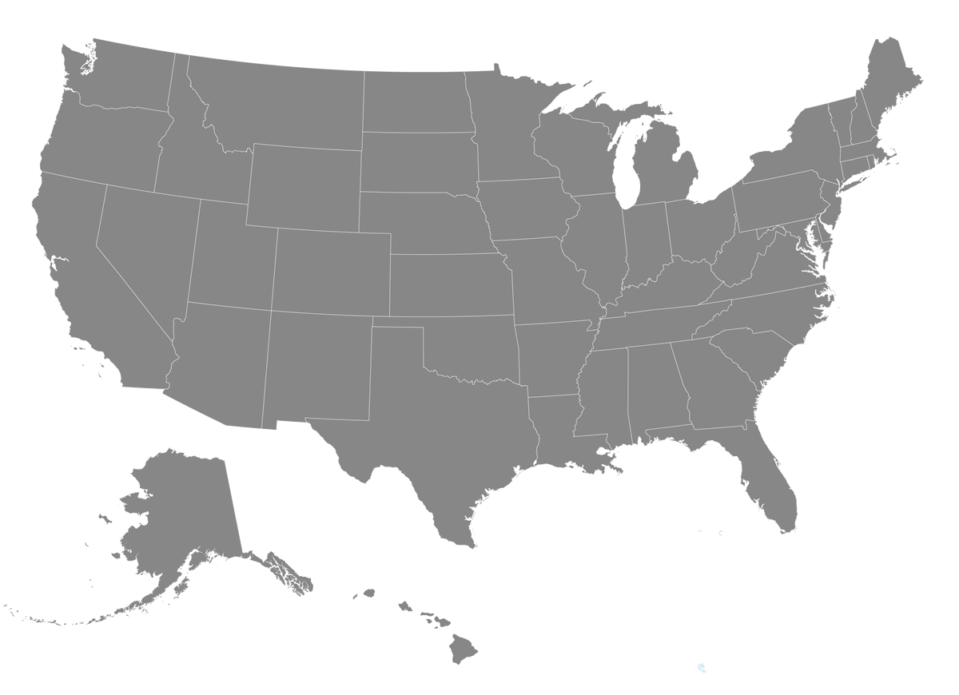


Go to Market Plan

Slide 9
Team & Advisors
Technology Advisors:
Francesco Pierangeli - Blockchain in business expert, PhD at King’s College London
Moritz Platt - Software engineer, PhD at King’s College London
Michael Goldman - Blockchain Consultant
Education Advisor:
Nick Novak - Former COO of Arbor Education
Anton
Iqra
Lorenzo
Alex
Core
Team
Jorn
Yingtong

Slide 10

Financials & Market Potential
$100k+ for Development
Customer Acquisition
Growth

Slide 11
What we are looking for?
Advice
Connections
Seed Funding
Feedback on our financials and where we can improve
Introductions to other universities leaders and education professionals
100k to get started on development

Slide 12

Why now?
Increasing number of Graduates
Globalisation
Job Hopping
Digital Transformation
Relationship with Hult
Online Certifications

Slide 13
Thank You!
Fast, easy, and secure multi-sided platform for degree verification

Slide 14
Sources
https://www.bbc.co.uk/news/uk-42579634
http://www.credentialssolutions.net/solutions/transcriptsnetwork
https://polygant.net/the-cost-of-blockchain-projects/
https://polygant.net/the-cost-of-blockchain-projects/
https://www.codementor.io/freelance-rates/blockchain-developers
https://nces.ed.gov/fastfacts/display.asp?id=372
https://www.metro.us/lifestyle/are-micro-degrees-the-future-of-higher-education/zsJphh---Czgpd0JKEyP8E
https://news.elearninginside.com/future-education-microdegree/
https://medium.reinvent.net/skip-the-college-diploma-microdegrees-offer-a-new-way-to-stay-smart-and-competitive-3385c8e23e41?gi=e433dae8066d
https://www.independent.co.uk/life-style/millennials-jobs-career-work-salary-quit-young-people-study-a8361936.html
https://www.forbes.com/sites/larryalton/2018/01/22/millennials-arent-job-hopping-young-people-are-5-things-to-keep-in-mind/#282bffd310d8
https://www.classcentral.com/report/mooc-stats-2017/

